Slide 1



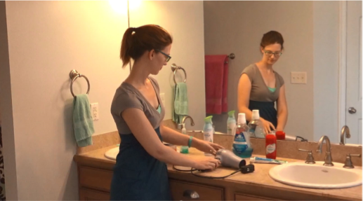
The Memory Benefits of Deadly Diseases: Increased Source Memory for Objects Touched by Individuals with Ebola
Kendal A. Smith, Matthew R. Gretz, Nicholas P. Maxwell & Mark J. Huff
Introduction
Threats of contamination from an infectious disease have been shown to activate a disease-avoidance system, termed the Behavioral Immune System (BIS). The BIS can facilitate cognitive processes in order to detect and retain sources of infectious disease. Recently, Gretz and Huff (2019) showed that both recall and source recognition are influenced by the presence of a disease state, as participants were more likely to correctly recall items that were touched by an actor when they were told that the actor was infected with influenza.
The present study examines how recall and source recognition are affected by Ebola, a disease that is both highly contagious and significantly life-threatening. Participants studied four videos depicting actors touching a subset of items in common household scenes. Prior to viewing each video, participants were informed that the actor was either diagnosed with Ebola, a highly contagious and deadly disease, Cancer, a non-contagious disease, or was healthy. Results showed that participants exhibited greater source recognition for items touched by actors infected with Ebola relative to those in the healthy and cancer conditions. However,
General Method
Results – Source Monitoring
Study
Four Scenes
Bedroom
Bathroom
Kitchen
Garage
Filler
Task
TEST
Free Recall
Source
Recognition
MMSE
Shipley
PVD
Demographics
Variable/Group Healthy Cancer Ebola
Touched Items
“Touched” 0.64(0.18) 0.64 (0.16) 0.69(0.16)
2
“Non-Touched” 0.29(0.19) 0.33(0.22) 0.24(0.22)
“Neither” 0.09(0.11) 0.08(0.10) 0.08(0.09)
Non-Touched Items
“Touched” 0.08(0.90) 0.10(0.13) 0.13(0.11)
“Non-Touched” 0.50(0.18) 0.53(0.17) 0.48(0.17)
“Neither” 0.41(0.21) 0.37(0.16) 0.39(0.14)
Non-Presented Items
“Touched” 0.03(0.06) 0.02(0.04) 0.06(0.09)
“Non-Touched” 0.16(0.16) 0.19(0.17) 0.14(0.14)
“Neither” 0.81(0.19) 0.79(0.20) 0.80(0.17)
Note: Two versions of the experiment were created, counterbalancing the order in which videos appeared.
Disease State Descriptions
Ebola: This individual has been diagnosed with Ebola, a highly contagious disease that can result in vomiting blood, dehydration, and death.
Cancer: This individual has been diagnosed with cancer, a noncontagious disease that can result in anemia, bodily lumps, and changes in digestion.
Healthy: This individual is healthy and is not afflicted with any ailments.
Note: Mean (sd) proportions of correct source attributions for touched, non-touched, and non-presented item as a function of healthy, influenza, and cancer disease groups
Variable/Group Healthy Cancer Ebola
Touched Items 0.57(0.12) 0.53(0.12) 0.55(0.11)
Non-touched Items 0.28(0.11) 0.27(0.09) 0.23(0.10)
Difference 0.29 0.26 0.32
Results – Free Recall
Conclusions
Materials
Four silent ,digital videos portraying a single female actor touching a series of common household objects were created. Each video focused on one of four unique household scenes (kitchen, bedroom, bathroom, garage). Videos were based off the social-contagion paradigm (Roediger, Meade, & Bergman, 2001) and were identical to those used by Gretz & Huff (2019).
Note: Mean (sd) proportions of correct recall, number of intrusions per list recalled as a function of healthy, influenza, and cancer disease groups
Variable/Group Healthy Cancer Ebola
N 41 41 44
Age (yrs.) 20.73(5.12) 19.68(2.33) 19.52(1.58)
Education (yrs.) 13.80(1.60) 13.15(1.24) 13.87(1.30)
MMSE 29.01(1.25) 29.20(1.05) 29.07(1.44)
% Female 85.37% 78.05% 86.36%
PVD 4.27(0.87) 4.07(0.90) 3.86(0.82)
Participant Characteristics
Note: M (SD)
Sample still image taken from the bathroom scene.
Correspondence can be addressed to mark.huff@usm.edu | Lab Website: www.macapsych.com

